Slide 1
Interpolants in Nonlinear Theories over the Reals
Sicun Gao and Damien Zuﬀerey
MIT CSAIL
2016.04.06 TACAS

Slide 2
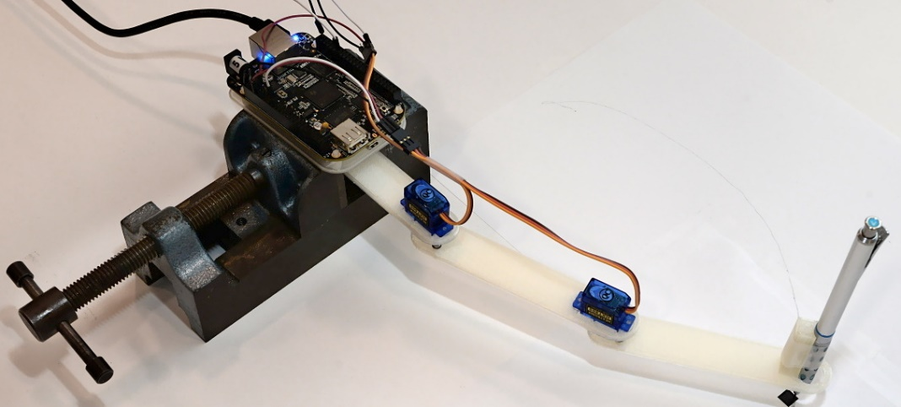
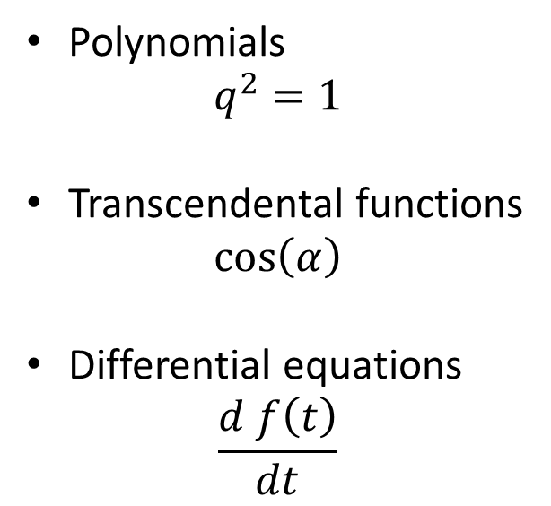
Motivation
Discrete
Polynomials
$$q^{2}=1$$
Transcendental functions
$$\cos\left(α\right)$$
Differential equations
$$\frac{d f\left(t\right)}{dt}$$
Continuous

Slide 3
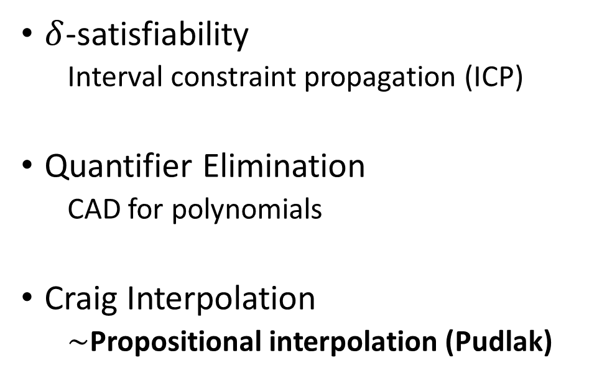
Reasoning About Continuous Formula
Linear
Nonlinear
Satisfiability
Linear programming
Quantifier Elimination
Fourier–Motzkin
Craig Interpolation
LP duality (Farkas Lemma)
$δ$-satisfiability
Interval constraint propagation (ICP)
Quantifier Elimination
CAD for polynomials
Craig Interpolation
$∼$Propositional interpolation (Pudlak)
?

Slide 4
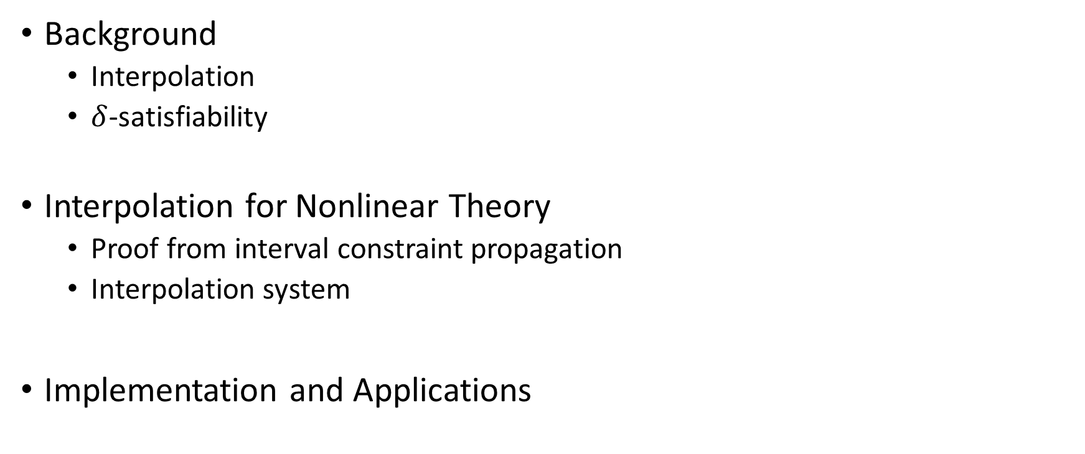
Outline
Background
Interpolation
$δ$-satisfiability
Interpolation for Nonlinear Theory
Proof from interval constraint propagation
Interpolation system
Implementation and Applications

Slide 5
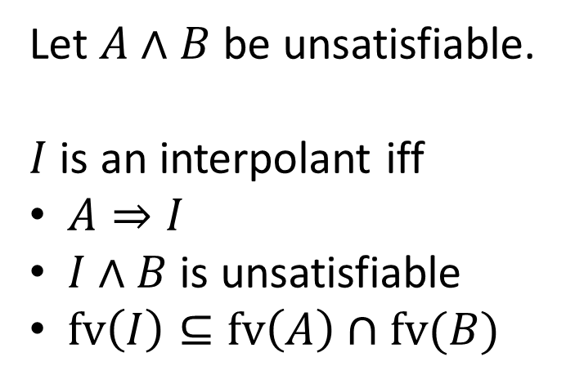
Craig Interpolation
I
Let $A∧B$ be unsatisfiable.
$I$ is an interpolant iff
$A⇒I$
$I∧B$ is unsatisfiable
$fv\left(I\right)⊆fv\left(A\right)∩fv(B)$
A
B
Usually, $I$ is computed from the unsatisfiability proof of $A∧B$.

Slide 6
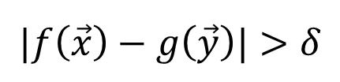
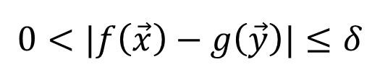

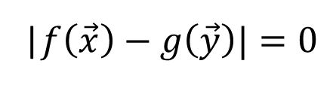

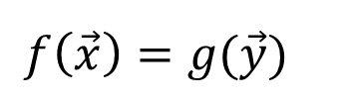

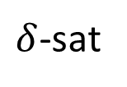
$δ$-Satisfiability
$ℝ$ + nonlinear theory $→$ undecidable
$ℝ$ + nonlinear theory + $δ$-perturbations $→$ decidable
|$f\left(\vec{x}\right)−g\left(\vec{y}\right)|=0$
$δ$-sat
$$f\left(\vec{x}\right)=g(\vec{y})$$
$$0<|f\left(\vec{x}\right)−g\left(\vec{y}\right)|≤δ$$
$δ$-sat / unsat
$$|f\left(\vec{x}\right)−g\left(\vec{y}\right)|>δ$$
unsat
$δ$-satisfiability captures numerical computability.

Slide 7

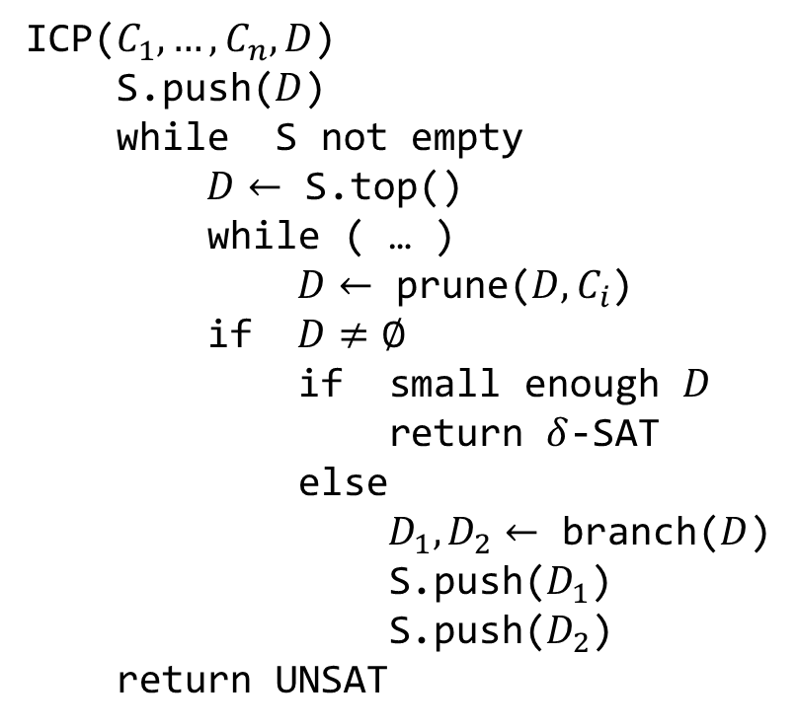


Branch-and-Prune ICP
ICP($C_{1},…, C_{n}, D$)
S.push($D$)
while S not empty
$D←$ S.top()
while ( … )
$D←$ prune($D, C_{i}$)
if $D≠∅$
if small enough $D$
return $δ$-SAT
else
$D_{1},D_{2}←$ branch($D$)
S.push($D_{1}$)
S.push($D_{2}$)
return UNSAT
$$D_{1}$$
$$D$$
$$D_{2}$$

Slide 8
Branch-and-Prune Example
Prune by B
Prune by A
Branch
Prune by A
Prune by B
Prune by A
Prune by B
A
B

Slide 9
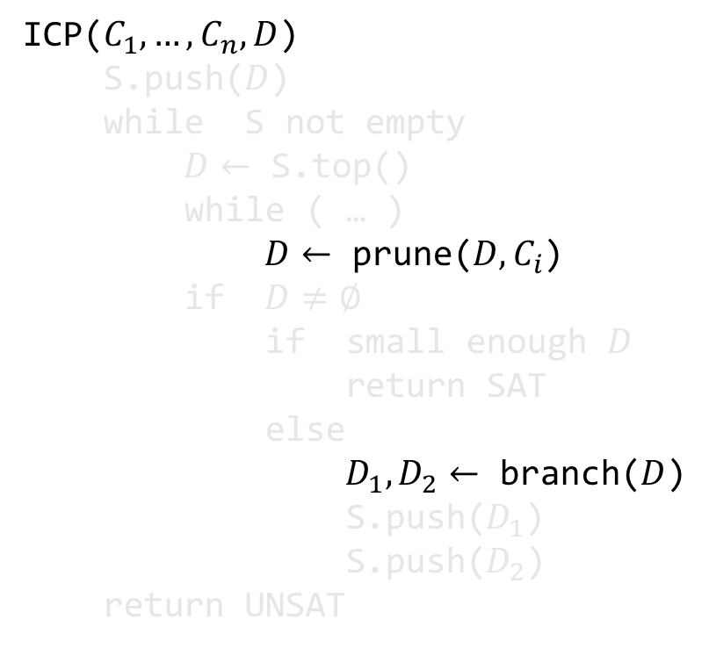

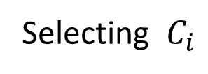
Proof from ICP: $D, C_{1..n}⊢ ⊥$
ICP($C_{1},…, C_{n}, D$)
S.push($D$)
while S not empty
$D←$ S.top()
while ( … )
$D←$ prune($D, C_{i}$)
if $D≠∅$
if small enough $D$
return SAT
else
$D_{1},D_{2}←$ branch($D$)
S.push($D_{1}$)
S.push($D_{2}$)
return UNSAT
Selecting $C_{i}$
Prune = Split + ThLem
Split

Slide 10
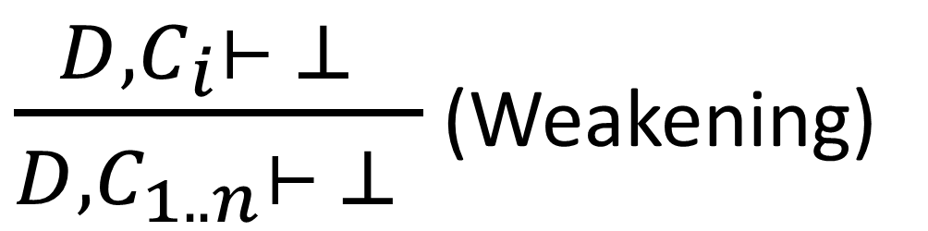

Selecting $C_{i}$
$\frac{D, C_{i}⊢ ⊥ }{D, C_{1..n}⊢ ⊥ }$ (Weakening)

Slide 11

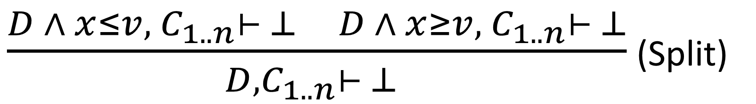



Branching
$$D_{1}$$
$$D_{2}$$
$$x$$
$$v$$
$\frac{D ∧ x≤v, C_{1..n}⊢ ⊥ D ∧ x≥v, C_{1..n}⊢ ⊥}{D, C_{1..n}⊢ ⊥ }$ (Split)

Slide 12

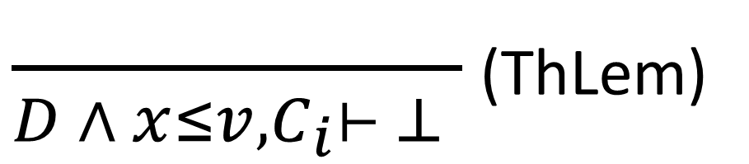

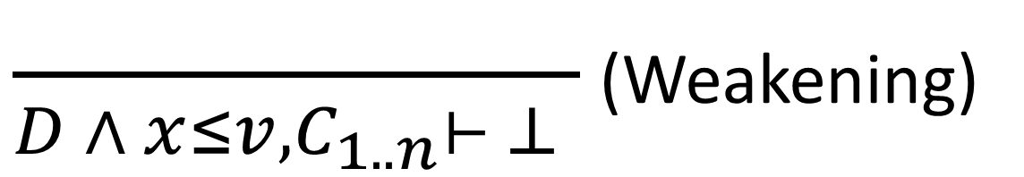
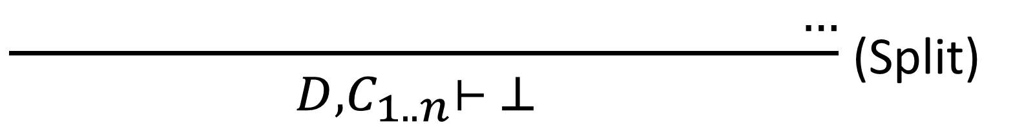

Pruning by $C_{i}$
$\frac{ }{D ∧ x≤v, C_{i}⊢ ⊥ }$ (ThLem)
$$x$$
$$v$$
$\frac{ }{D ∧ x≤v, C_{1..n}⊢ ⊥ }$ (Weakening)
$\frac{ …}{D, C_{1..n}⊢ ⊥ }$ (Split)

Slide 13

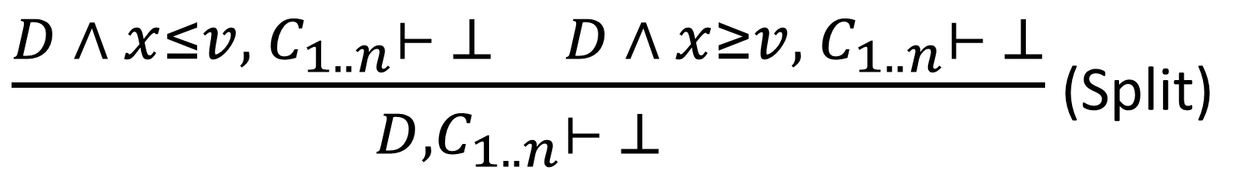
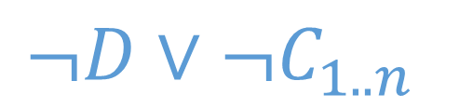

ICP Produces Resolution Proofs
$$¬D∨V∨¬C_{1..n}$$
$$¬D∨¬V∨{¬C}_{1..n}$$
$\frac{D ∧ x≤v, C_{1..n}⊢ ⊥ D ∧ x≥v, C_{1..n}⊢ ⊥}{D, C_{1..n}⊢ ⊥ }$ (Split)
$$¬D∨¬C_{1..n}$$

Slide 14

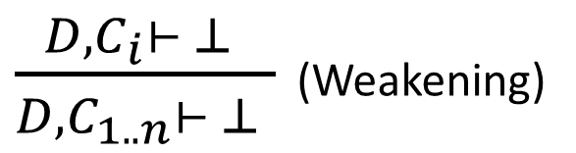

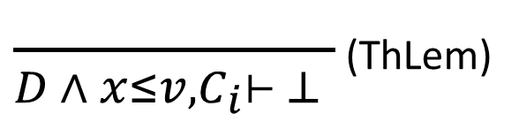


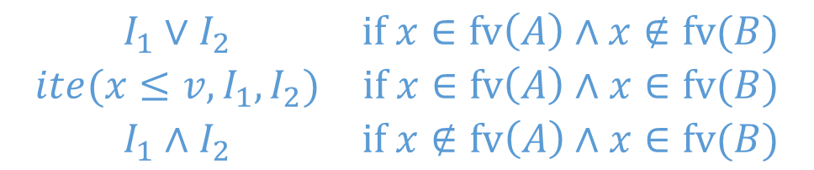
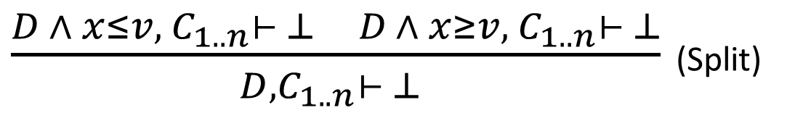

Interpolation Rules
$$I$$
$\frac{ }{D ∧ x≤v, C_{i}⊢ ⊥ }$ (ThLem)
$\frac{D, C_{i}⊢ ⊥ }{D, C_{1..n}⊢ ⊥ }$ (Weakening)
$$C_{i}∉A$$
$$I$$
$$I_{1}$$
$$I_{2}$$
$\frac{D ∧ x≤v, C_{1..n}⊢ ⊥ D ∧ x≥v, C_{1..n}⊢ ⊥}{D, C_{1..n}⊢ ⊥ }$ (Split)
$$\begin{matrix}I_{1}∨I_{2} & if x∈fv\left(A\right)∧x∉fv(B) \\ ite(x≤v, I_{1}, I_{2}) & if x∈fv\left(A\right)∧x∈fv(B) \\ I_{1}∧I_{2} & if x∉fv\left(A\right)∧x∈fv(B)\end{matrix}$$

Slide 15
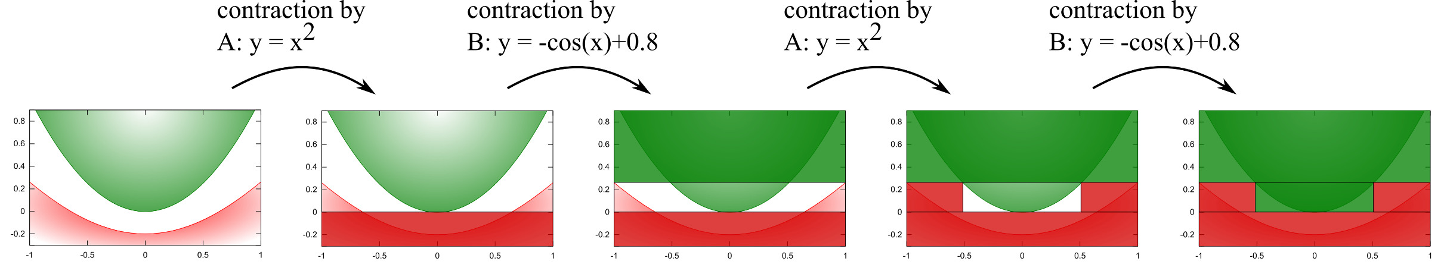
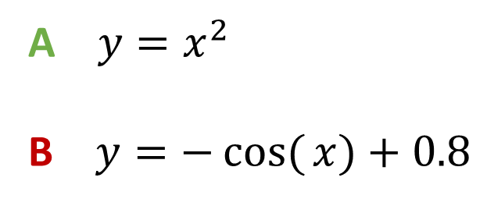
Example
A $y=x^{2}$
B $y=−cos({x)}+0.8$

Slide 16
Implementation
Implemented in the dReal SMT-solver:
https://github.com/dzufferey/dreal3/
https://github.com/dreal/dreal3/
Evaluation in the paper
Computing interpolants for examples such as
QF_NRA
Control theory and robotic systems
Biological systems
Report interpolant size vs proof size, runtimes, etc.

Slide 17

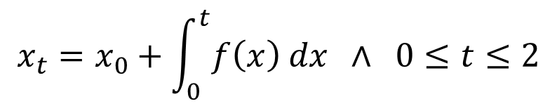



Ordinary Differential Equations
$$x_{t}=x_{0}+\int_{0}^{t}{f\left(x\right) dx} ∧ 0≤t≤2$$
How can we handle:
An ODE is just a pruning operator over the domain
$$t$$
$$x_{t}$$
$$x_{0}$$

Slide 18
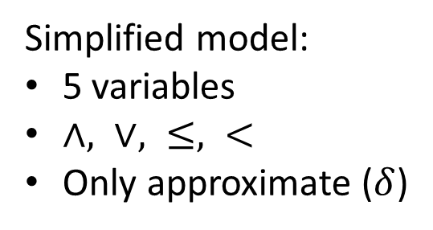
Interpolation as Weak Quantifier Elimination
Kinematic chain
Automatically extracted model:
30 variables
poly. deg. 2, trig. fct.
Simplified model:
5 variables
$∧, ∨, ≤, <$
Only approximate ($δ$)
Interpolation

Slide 19
Related Works
Labelled interpolation systems, D’Silva et al. 10
Linear arithmetic:
ℤ: Brillout et al. 10, Griggio et al. 11
ℚ: McMillan 04, Rybalchenko & Sofronie-Stokkermans 07
Polynomials over ℝ using semi-definite prog. Dai et al. 13
Tools to compute interpolants: MathSat5, Princess, SmtInterpol, Z3

Slide 20
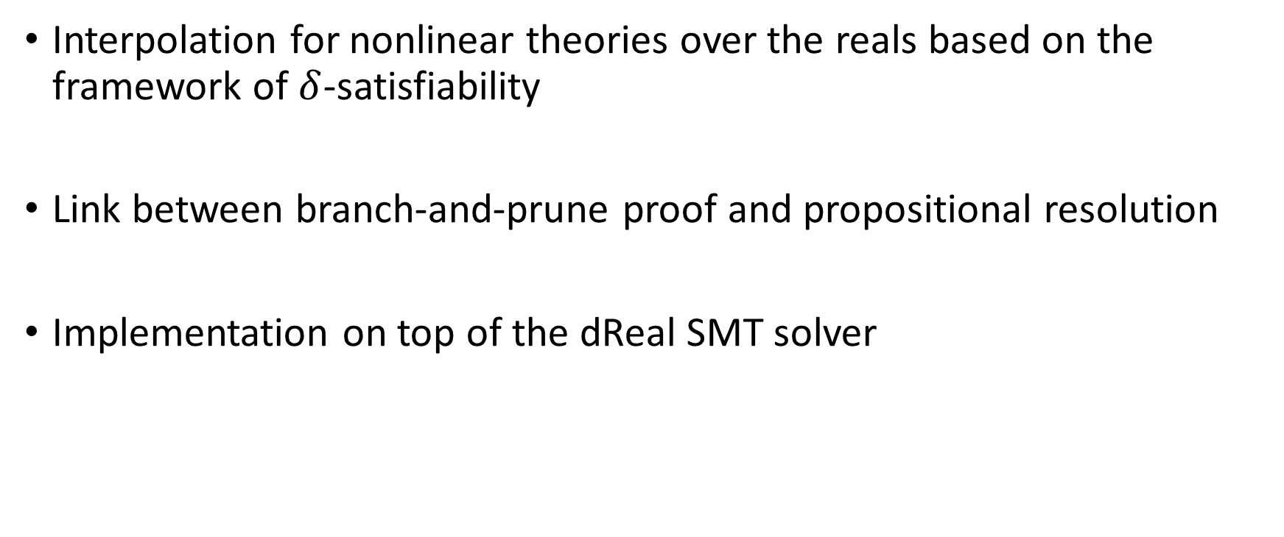
Conclusion
Interpolation for nonlinear theories over the reals based on the framework of $δ$-satisfiability
Link between branch-and-prune proof and propositional resolution
Implementation on top of the dReal SMT solver

